Slide 1
Emerging Technologies
Chapter Four
Internet of Things (IoT)

Slide 2
Outline
Overview of IoT
How Does It Work?
IoT Tools and Platforms
Applications of IoT

Slide 3
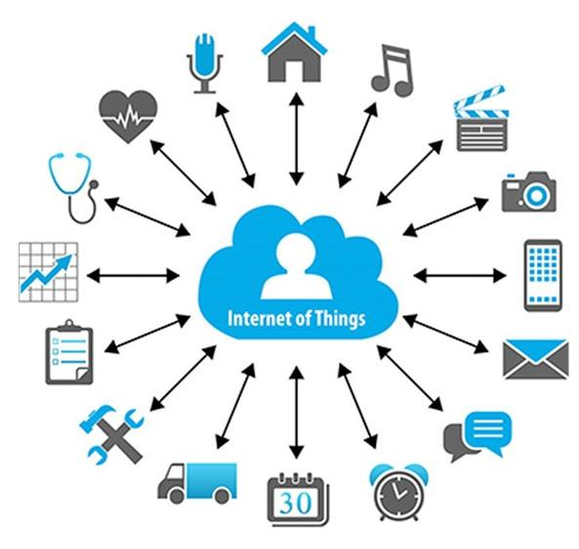
Learning outcomes
After completing this chapter, you should be able to:
Describe IoT
Explain how IoT works
Explain the architecture of IoT
Describe application areas of IoT
Describe the pros and cons of IoT
Describe IoT tools and platforms
Notes:
Things in this picture are connected to the Internet and to each other through an IoT network.
Extending the current Internet and providing connection and communication between and with everything.

Slide 4
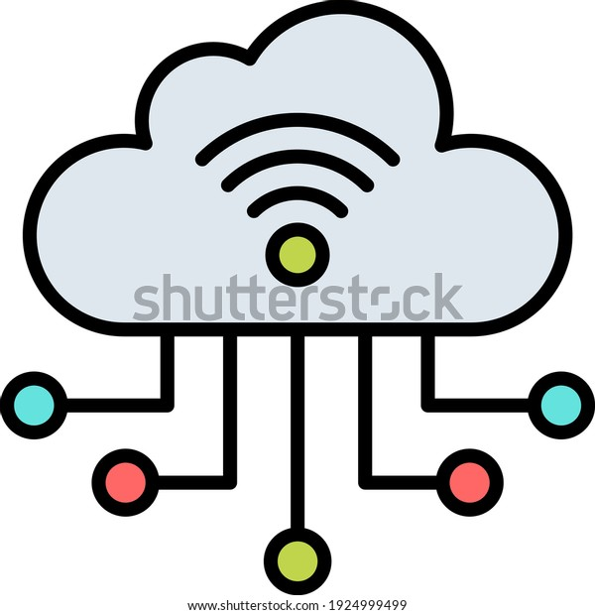
Internet of Things (IoT)
Extending the current Internet and providing connection, communication, and inter-networking between devices and physical objects, or "Things," is a growing trend that is often referred to as the Internet of Things.
“The technologies and solutions that enable integration of real world data and services into the current information networking technologies are often described under the umbrella term of the Internet of Things (IoT)”
Notes:
[Q] What is in communication? What do we mean by it?
There is exchange of data.
The Internet of things describes the network of physical objects—a.k.a. "things"—that are embedded with sensors, software, and other technologies for the purpose of connecting and exchanging data with other devices and systems over the Internet. Wikipedia

Slide 5
Internet of Things (IoT)
Definition: Where Internet connectivity becomes expanded to everyday devices such as cars, home appliances, clothes, city infrastructure, and medical and healthcare devices.
One example of rapidly growing industry IoT: autonomous or driverless cars.
IoT devices cut across industries. Their interconnection forms systems typically described as “smart houses”, “smart cities”, and eventually “smart countries”.
Notes:
Smart phone, Smart watch, Smart TV,
[Q] What does smart signify in IoT perspective or in general terms?
In the smart part is connectivity and seamless exchange and analysis of real-time data enabling to take immediate
actions and to provide efficient services to users of the smart thing.
In a way not experienced before or not experienced under normal circumstances.
AI has a great role to play in IoT.

Slide 6
Internet of Things (IoT)
The internet of things, or IoT, is a system of interrelated computing devices, mechanical and digital machines, objects, animals or people that are provided with unique identifiers (UIDs) and the ability to transfer data over a network without requiring human-to-human or human-to-computer interaction.
Notes:
A thing in the internet of things can be a person with a heart monitor implant, a farm animal with a biochip transponder, an automobile that has built-in sensors to alert the driver when tire pressure is low or any other natural or man-made object that can be assigned an Internet Protocol (IP) address and is able to transfer data over a network.
[Q] How can you relate AI, Big data, and IoT?

Slide 7
Interplay between AI, Big Data and IoT
Key interplay between:
AI: Data-based learning
Big data: Capture, storage, analysis of large volume of data
IoT: Data collection (and processing) through network of things
Data collected by IoT sensors contributes to building large pools of data (Big data) which, in turn, can be processed and used for the development of ML and AI.
Connected devices in IoT generate Big data and we know Big data requires AI to be processed, and AI requires Big data for learning.
IoT = Data + Sensors + Networks + Services
Notes:
In the IoT equation, Services represent cloud computing (distributed computing) services, platform services, AI, management and other applications.
By management we mean: remotely monitoring, updating, and controlling things.
Moreover, data as a service can be provided using IoT through cloud services.
Billions of connected devices generate vast amounts of data every moment.
This large amount of unstructured (semi structured) data generated by IoT devices is Big data.
The Internet of Things facilitates device connection and produces a large amount of data about some desired process.
Artificial Intelligence analyzes data collected by IoT enabled devices and extract patterns and process behaviors then make a decision based on those patterns.
These technologies, working together, can solve real-world problems and create new products.
For example, using only IoT, we have connected cars. But, using AI with IoT, we have self-driving cars.
i.e. using only the connectivity & communication aspect of IoT, we only have connected cars.

Slide 8
Interplay between AI, Big Data and IoT
Key interplay between:
AI: Data-based learning
Big data: Capture, storage, analysis of large volume of data
IoT: Data collection (and processing) through network of things
Data collected by IoT sensors contributes to building large pools of data (Big data) which, in turn, can be processed and used for the development of ML and AI.
Connected devices in IoT generate Big data and we know Big data requires AI to be processed, and AI requires Big data for learning.
IoT = Data + Sensors + Networks + Services
Notes:
The Real Value of IoT is extracting meaningful patterns from generated data and make a decision or even prediction based on those patterns.
It is impossible without using AI-driven Big-data processing.
Without AI, IoT is a static technology that facilitates device connections and that automates data collection.
Using AI with IoT, one can create real smart devices with the ability of learning, self-improvement, and decision making.
Voice-enabled Google home is an interesting example of combining Google AI with IoT enabled smart home devices.
Thus, people can control home appliances with their voices.
Embedding AI in IoT devices called Edge AI can create attractive, cost-effective, and Real-time IoT applications.
Smart Watch is an excellent use case of Embedded AI, which can detect hard fall and call emergency services.

Slide 9
Things
Things are objects of the physical world (physical things) or of the information world (virtual world) which are capable of being identified and integrated into communication networks. Things have associated information, which can be static or dynamic.
Notes:
[Q] How can things in IoT be connected and uniquely identified?
The practical and feasible way is using WSN, RFID, and IP.

Slide 10
Things
Physical things exist in the physical world and are capable of being connected, identified, sensed, located, and actuated/controlled.
Virtual things exist in the information world and are capable of being stored, addressed, processed and accessed.
Notes:
Examples of physical things include things of the surrounding environment, industrial robots, goods and electrical equipment.
Examples of virtual things include multimedia content and application software.
[Q] Have you tried the “Where am I?” question on the internet? How does it work?

Slide 11
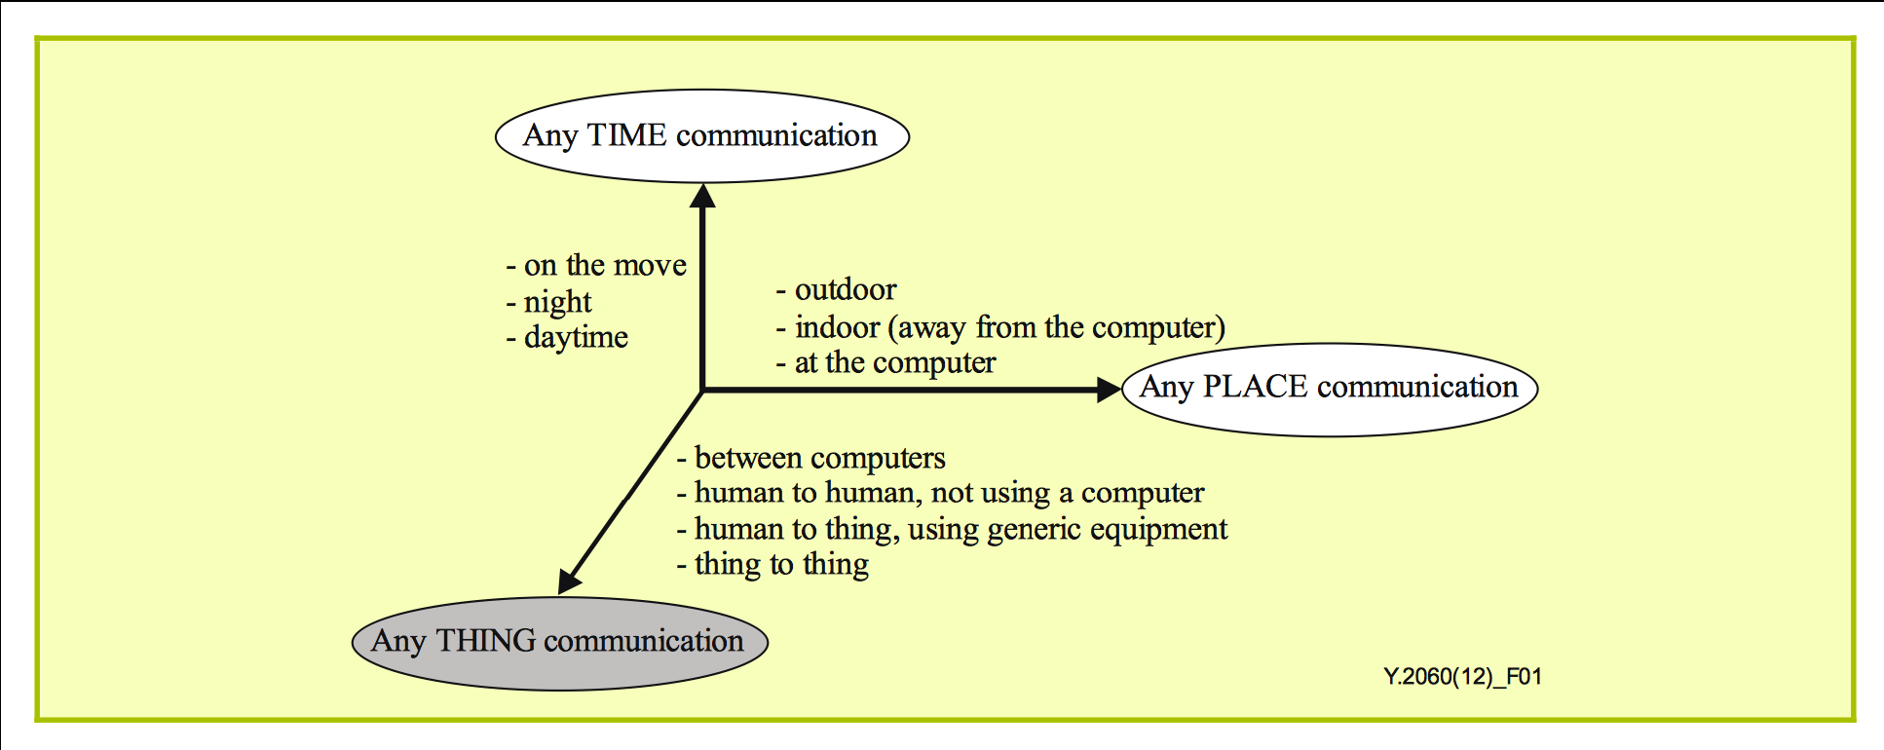
Any-Time/Any-Place/Any-Thing
Notes:
The vision underlying the Internet of things will allow information to be accessed "anytime“, "anywhere (anyplace)" from "anything".
This will be facilitated by using WSNs, RFID tags, and also IPv6.
[Q] Why IPv6? Why not IPv4?
Why WSN? WSN: Wireless Sensor Node and Wireless sensor networks.
WSNs are the building blocks of IoT. Like LANs are the building blocks of the Internet.
Any time, any place (or any where), anything communications is one of the characteristics of IoT.

Slide 12
Why should you learn about IoT?
Emerging technology
Growing IoT Services and Applications in various areas including smart cities, healthcare, transport, logistics, retail, safety and security, etc.
Business trends and new opportunities
Notes:
IoT is an emerging technology and possibly will affect everything and everyone.
Growing IoT Services and Applications and lots of opportunities.
The internet of things helps people live and work smarter, as well as gain complete control over their lives.
In addition to offering smart devices to automate homes, IoT is essential to business. IoT provides businesses with a real-time look into how their systems really work, delivering insights into everything from the performance of machines to supply chain and logistics operations.
IoT enables companies to automate processes and reduce labor costs. It also cuts down on waste and improves service delivery, making it less expensive to manufacture and deliver goods, as well as offering transparency into customer transactions.

Slide 13
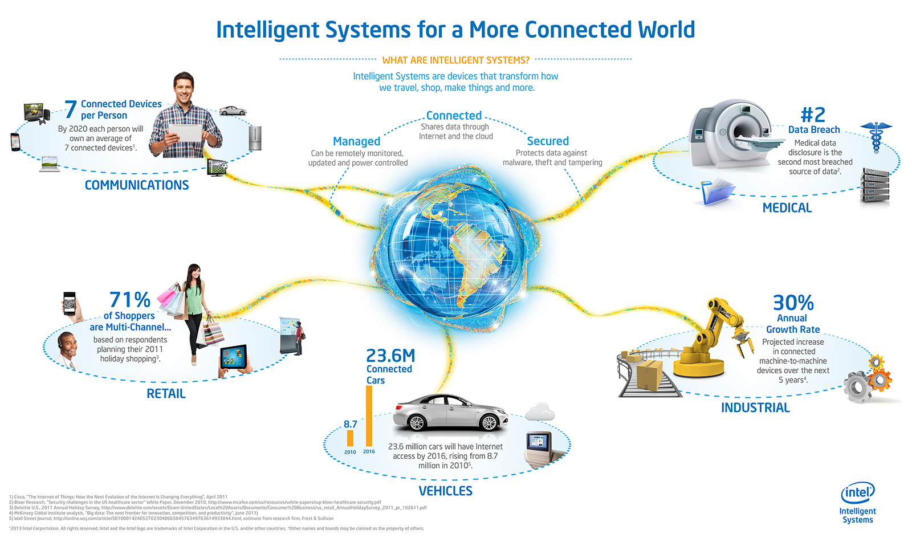
Opportunities & Challenges
Notes:
Intelligent systems are devices that transform how we travel, shop, make things and more.
A lot of growth in connectivity therefore lots of opportunities.
Communications: By 2020 each person will own an average of 7 connected devices.
Retail: 71% of shoppers are multi channel (anything, anywhere, anytime).
Vehicles: Tens of millions of cars have internet access.
Industrial: 30% annual growth rate in connected machine to machine devices in the coming years.
Medical: Data disclosure is the second most breached source of data. Thus, IoT has security concerns.

Slide 14
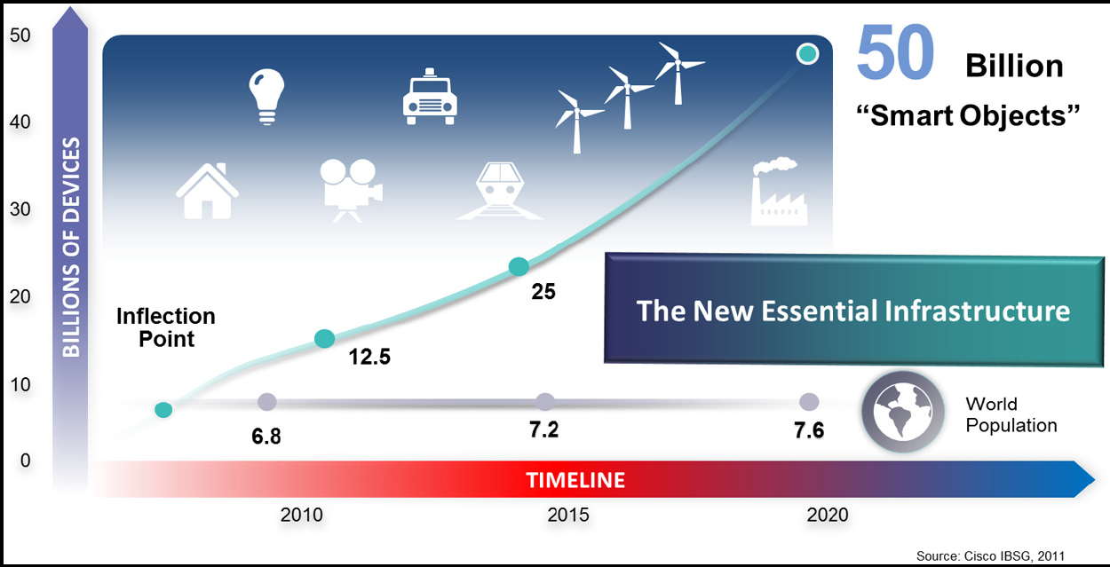
Internet-connected devices and the future evolution (Source: Cisco, 2011)
Notes:
The IoT is the new essential infrastructure.
IoT and Internet are not the same thing. Internet by itself is a world wide network infrastructure.

Slide 15
The Internet of Things enables a smarter bridging of digital, physical and human spheres by adding data capture and communication capacities to objects in a secure way to a networked environment.
It’s clear that none of the technologies we have seen so far and others stand on their own, technologies such as edge computing, in combination with cloud computing and on-premises, big data analytics, artificial intelligence and machine learning and far more are involved. Precisely because of IoT collected data indeed.
It is not just about the connected devices but also about the hardware, software, connectivity and communication protocols, middleware and so much more to create Internet of Things solutions as mentioned. And it’s also about many processes and technologies (big data, analytics, cloud computing, edge computing / fog computing, IoT platform software, IoT gateways etc.) which are needed to do something with the Internet of Things.

Slide 16
More IoT Definitions and Issues
A network of connected devices
1) With unique identifiers in the form of an IP address and other addressing and tracking techniques, and
2) Which have embedded technologies or are equipped with technologies that enable them to sense, gather data and communicate about the environment in which they reside and/or about themselves.
Notes:
How can devices be uniquely identified? How can devices or people be tracked?
Through IP addresses and RFID tags or hardware addresses.
A good example (common and practical) use of RFID is in car door locks and steering wheel locks.
[Q] What are the enablers or drivers of IoT?
IoT is being enabled or driven by miniaturization, wireless connectivity technologies, and increased data storage and processing capabilities.
And there are more other drivers of IoT . . .

Slide 17
Definition of IoT as a foundation and enabler
IoT is an umbrella term which describes a multi-faceted foundation for a range of applications and goals which are enabled through the connection of items (devices, sensors, tagged beings), equipped with data capture and communication capabilities, uniquely identifiable and connectable, in order to transmit and/or receive data for a clear human, business or societal purpose.

Slide 18
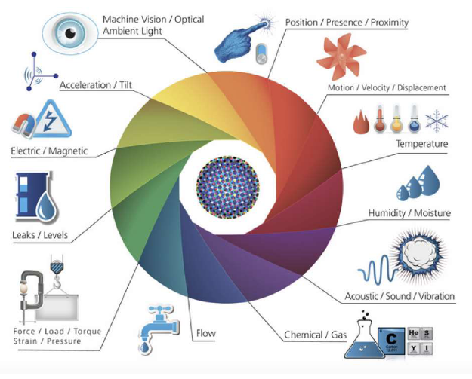
What is to be sensed in IoT?
Notes:
Properties of the environment to be sensed in IoT.
In which we can see the many types of sensors used in IoT.
Thus, IoT can be used for numerous applications.
[Q] Which sensors shall we use to develop road traffic monitoring & management applications, for example?
Machine vision or computer vision; Presence / Proximity sensor, GPS/Position sensor, Speed sensor, etc. Investigate to know more!

Slide 19
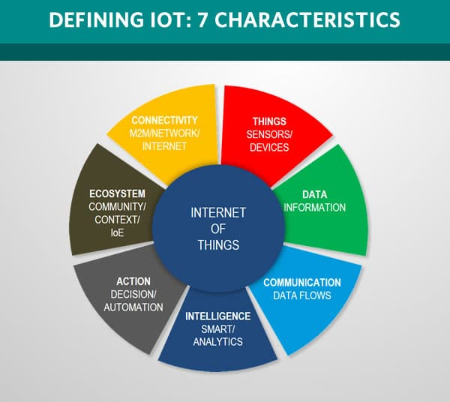

Slide 20
There are 7 essential IoT characteristics:
1. Connectivity: With everything going on in IoT devices and hardware, with sensors and other electronics and connected hardware and control systems, there needs to be a connection between various levels.
2. Things: Anything that can be tagged or connected as such it’s designed to be connected. From sensors and household appliances to tagged livestock. Devices can contain sensors or sensing materials & can be attached to devices and items.
Notes:
What do we mean by tagged? What do you think designed to be connected mean?
Attach a label or monitoring tag to something.
They have transceivers embedded in or tagged to the devices.

Slide 21

Connectivity: WSN
A Wireless Sensor Network is a self-configuring network of small sensor nodes communicating among themselves using radio signals, and deployed in quantity to sense, monitor and understand the physical world.
Wireless Sensor nodes are called motes.
Notes:
Wireless Sensor Networks are built from numerous Wireless Sensor Nodes.
Mote: a tiny piece of a substance; a tiny spot; a small particle of a substance. Dictionary meaning.
For example, a Bluetooth enabled wearable device measures heart rate and sent it to a smartphone or a server over the internet.

Slide 22
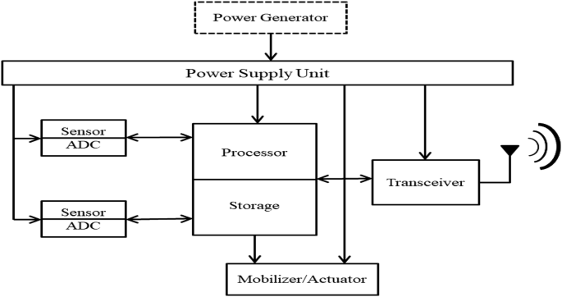
Connectivity: Mote Anatomy
Notes:
The Internal Organization of a Wireless Sensor Node.
[Q] What would be the practical power generator or power supply unit for this device?
Solar panel or AA size small batteries, or coin batteries.
[Q] What is the need for ADC?
[Q] What is a Transceiver?
[Q] What would it receive? Control Signals or Commands.
[Q] What about unique identification? We need to tag it with RFID.
To drive an actuator we may need DAC.

Slide 23
Mote (WSNode) Anatomy
Processor in various modes (sleep, idle, active)
Power source (AA or Coin batteries, Solar Panels)
Memory used for the program code and for in-memory buffering
Radio used for transmitting the acquired data to some storage site, and also the other way
Sensors for temperature, humidity, light, etc.
Notes:
[Q] What is the meaning or advantage of the processor being in different modes?
The processor need not to be active all the time. Why?
Most of the time in sleep mode, controlled by a piece of code in memory or remotely controlled.
When processor is in sleep or idle mode, that is the case most of the time, battery power is saved.
WSN devises are designed to collect data periodically. For example, once a day or once per minute.
Devices can be turned on and off and/or controlled remotely.

Slide 24
Connectivity: Mote Anatomy
These motes are highly constrained in terms of
Physical size, CPU power, Memory (few tens of kilobytes), Bandwidth (Maximum of 250 KB/s, lower rates the norm)
Power consumption is critical
If battery powered then energy efficiency is paramount
Batteries might have to last for years
May operate in harsh environments
Challenging physical environment (heat, dust, moisture, interference)
Notes:
[Q] Why are the wireless sensor nodes highly constrained in all the terms given above?
To make them very small, to make them use less energy, thus making them convenient to be deployed in large quantities.
To massively deploy them over large areas and use them for a long period with a small power source.

Slide 25
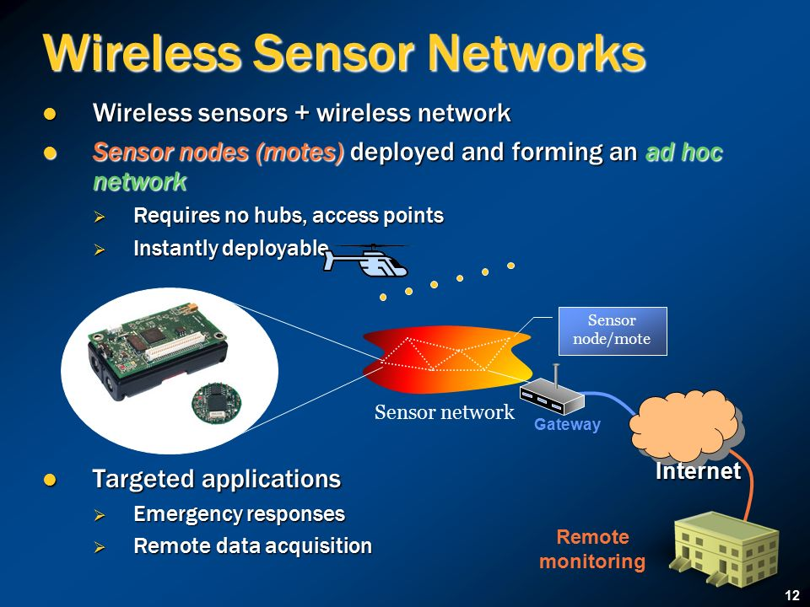
Notes:
Wireless sensor networks = Wireless sensor nodes + Wireless network protocol (software).
Wireless sensor networks may or may not require hubs, depending on the design or topology.
Ad hoc: created or done for a particular purpose as necessary.

Slide 26
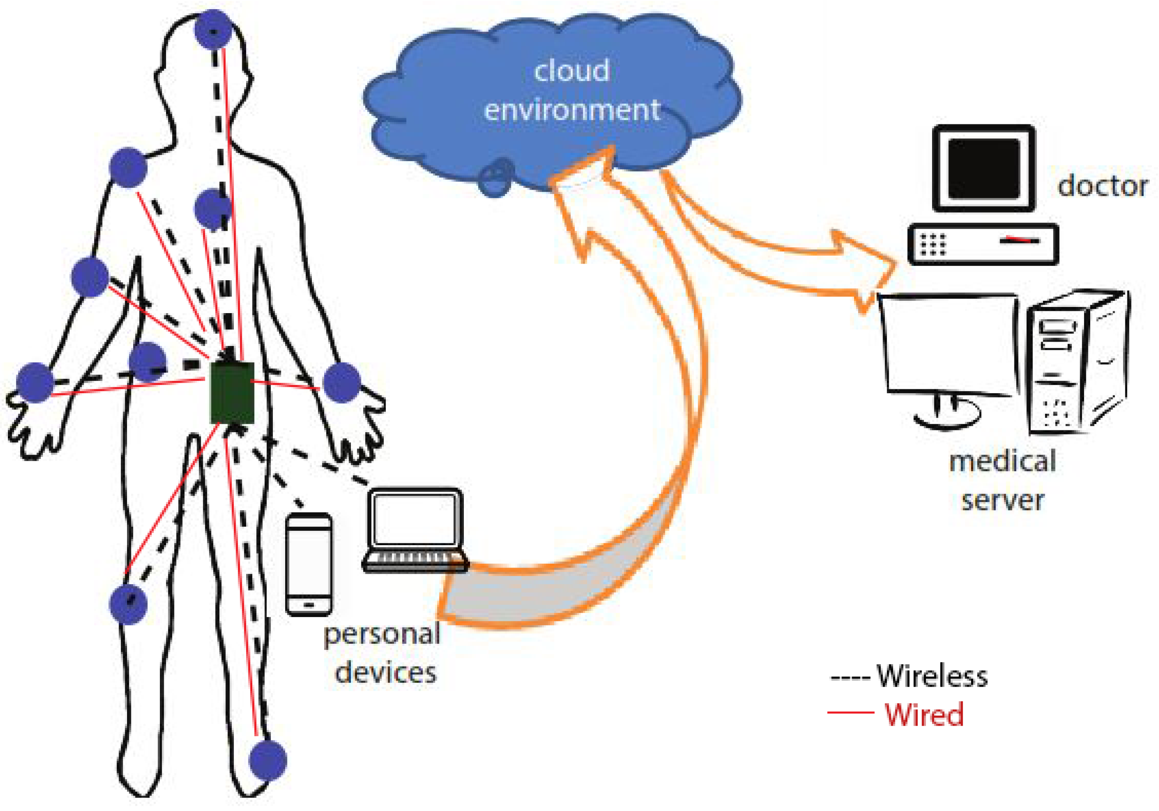
Body Sensor Networks
Notes:
Body sensor networks are one type of IoT.
[Q] Can you identify the wireless sensor nodes, hub, and gateways in this network?
This is a typical example of IoT, With cloud services and medical application in real time use (diagnosis).

Slide 27
There are 7 crucial IoT characteristics:
3. Data. Data is the glue of the Internet of Things, the first step towards action and intelligence.
4. Communication. Devices get connected so they can communicate data and this data can be analyzed. Communication can occur over short distances or over a long range to very long range. Example protocols: Wi-Fi, & LoRa.
5. Intelligence. The aspect of intelligence as in the sensing capabilities in IoT devices and the intelligence gathered from big data analytics (also artificial intelligence).
Notes:
Here, according to 5, intelligence (big data analytics and AI) is gathered from external sources, or gathered from AI cloud services.
Therefore, pay attention to the two types of intelligence gathered from sensors which is not AI and is internal, and
Intelligence gathered from external sources (data analytics & AI, gathered through services and/or APIs) or from its ecosystem.

Slide 28
There are 7 crucial IoT characteristics:
6. Action. The consequence of intelligence. This can be manual action, action based upon debates regarding phenomena (for instance in smart factory decisions) or automation, often the most important piece.
7. Ecosystem. The place of the Internet of Things from a perspective of other technologies, communities, goals and the picture in which the Internet of Things fits. The Internet of Everything dimension, the platform dimension and the need for solid partnerships.
Notes:
Ecosystem: the complex network and/or interconnected systems (Sine-Mehedar).
Ecosystem: The IoT ecosystem includes People, the environment, IoE, and other systems (system of systems), SW & HW.
IoE: Internet of everything; animate, inanimate and virtual things.

Slide 29
Reading Assignment: The Following topics are left as a reading assignment for you.
History of IoT
Advantages, Disadvantages, and Challenges of IoT

Slide 30
The key components of an IoT deployment from a high-end perspective are:
The environment (sensing and data capture, in some cases analysis at the edge).
Connectivity within the endpoint environment where data from sensors and to actuators are transmitted, and received in hubs (or gateways).
Connection with the cloud and applications, in some cases middleware, called IoT platforms.
The actual outcomes in the form of the end customer application and/or process integration/automation and/or services.
Notes:
Analysis at the edge: Analysis of data at the gateways and within smart objects. What we call edge and/or fog computing.
What is the advantage of analysis (or processing) at the edge? Increased performance.

Slide 31
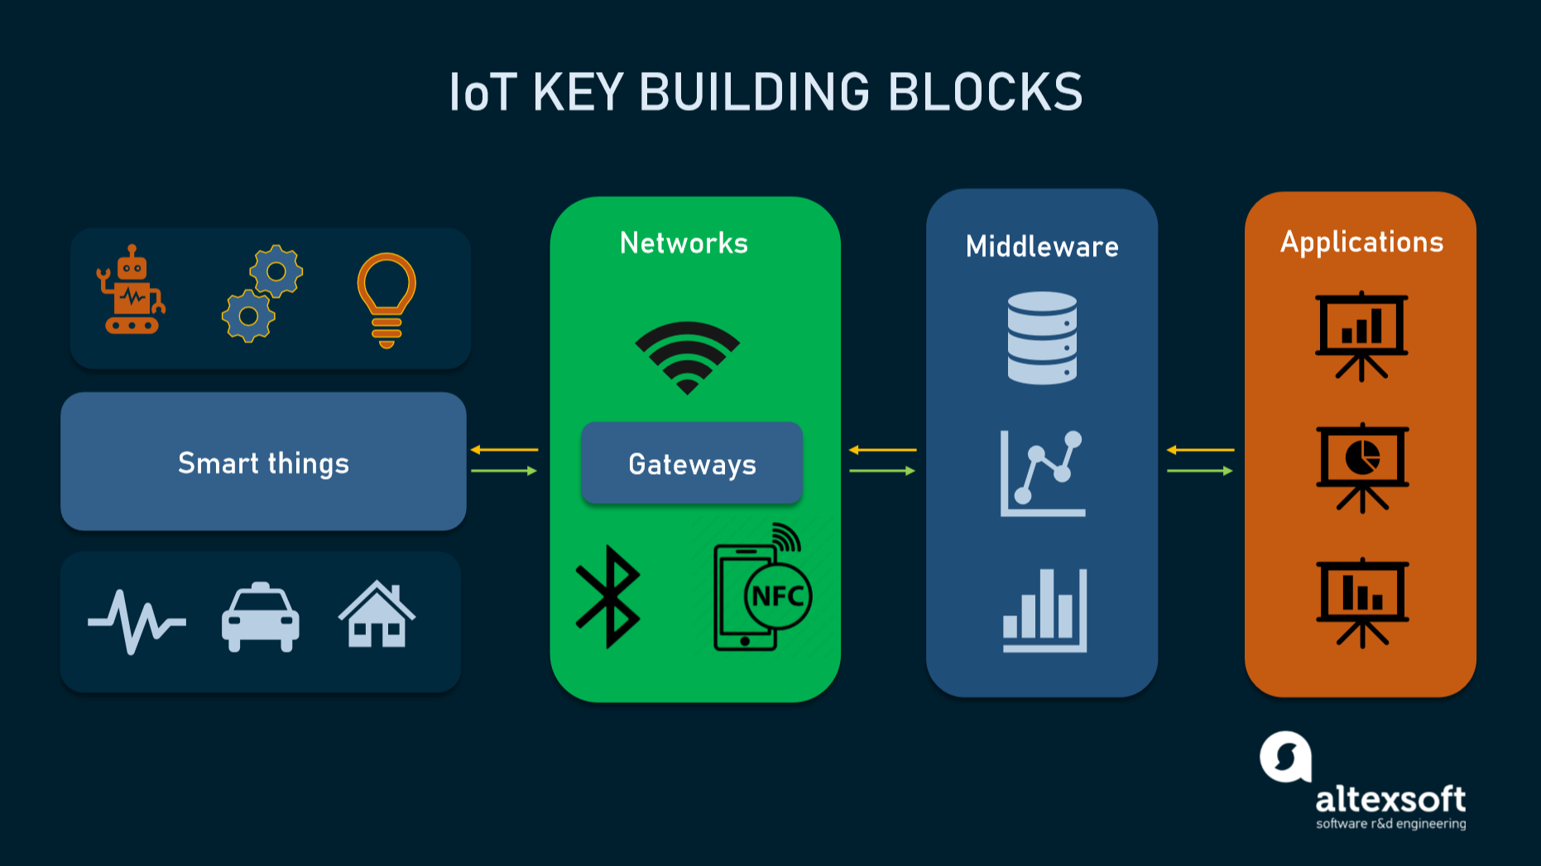
Notes:
Smart things are end points where sensors and actuators are located.
Smart things and networks represent the edge in this picture.
Tesla (for example) can troubleshoot car problems through IoT, remotely from the applications layer.
The middleware is where data analytics, AI, and many other services are residing.
Applications layer is where customers and end users are served with decision support information and control is sent from.

Slide 32
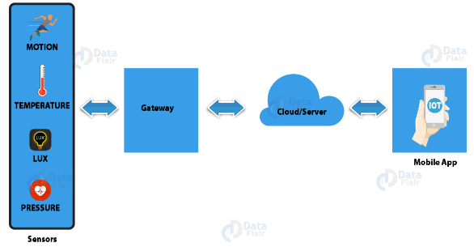
How IoT works?
IoT devices share the sensor data they collect by connecting to an IoT gateway or another edge device where data is either sent to the cloud to be analyzed or analyzed locally.
Notes:
What do we call local analysis?
Edge computing, or fog computing.

Slide 33
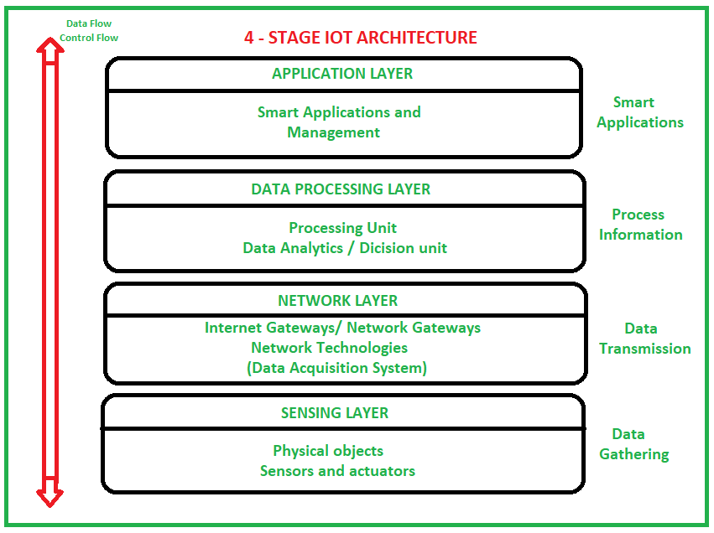
Notes:
[Q] Can you identify (pinpoint) directions of dataflow and control flow.
Control direction is top down, while dataflow is bottom up.
Bottom – Up : Collect → Communicate → Process (Analyze) → Act (Decide what to do)
We can possibly call this Low Level Abstraction of the Internet of Things.
We can also call it as Logical Level Abstraction or Design Level Abstraction of IoT.

Slide 34
Notes:
The Internet of Things Lifecycle may look like as shown in this picture.
This can be termed as a high level abstraction of the internet of Things.
Or we can likely call it Conceptual Level Abstraction.

Slide 35
Notes:
Model: is an abstraction of complex reality.

Slide 36
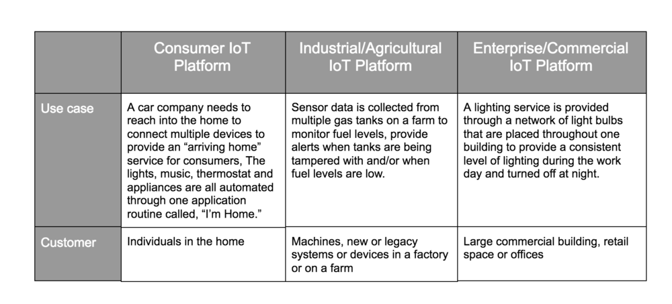
Devices and Networks
consumer, enterprise, and industrial IoT
Applications and use cases
Notes:
IoT devices are meant to work in concert for people at home, in industry or in the enterprise.
As such, the devices can be categorized into three main groups: consumer, enterprise and industrial. Page 72 of module.
This discussion is about IoT device categorization and their case of use.
Then the discussion about Network & Device Management Platform for IoT will follow.
Use case: a specific situation in which a product or service could potentially be used.
Enterprise: A Business or Company.
Industry: a particular form or branch of economic or commercial activity.
Consumer: Individual users, Individual customers for personal use.

Slide 37
IoT Tools & Platforms
There are many vendors in the industrial IoT platform marketplace, offering remarkably similar capabilities and methods of deployment.
IoT Platform | Key Features (Services)
KAA | Manage an unlimited number of connected devices Set up cross-device interoperability Perform real-time device monitoring Perform remote device provisioning and configuration Collect and analyze sensor data Analyze user behavior and deliver targeted notifications Create cloud services for smart products
Notes:
These IoT Platform Solutions are based on the Internet of Things and cloud technology.
They can be used in areas of smart home, city, enterprise, home automation, healthcare or automotive industry, just to name a few.
Kaa is a 100% open-source middleware platform for developing and managing complete end-to-end IoT solutions, connected applications, and smart products. Kaa provides a feature-rich toolkit for IoT product development and dramatically reduces associated costs, risks, and time-to-market.
As said many times, tools and platforms make life of developers (software engineers) much easier.

Slide 38
IoT Tools & Platforms
The most important services offered by an IoT cloud platform are application development, device management, system management, heterogeneity management, data management, tools for analysis, deployment, monitoring, visualization, and research.
All the computing resources offered by an IoT Platform can be rapidly provisioned and released with minimal management effort or service provider interaction.
Notes:
What do you think is the advantage we get through the second part note? Efficient use of resources. We can pay as we go. The as a service concept!
You have to get hands-on experience by attempting to use the open tools and platforms available to get a better understanding.

Slide 39
IoT Tools & Platforms
Briefly discuss the IoT development tools listed below.
(Activity 4.8, page 76 of module).
Tessel 2 Eclipse IoT Arduino PlatforIO IBM Watson | Raspbian OpenSCADA Node-RED Kimono Create Device Hive
44
Notes:
This is left as a reading assignment for you to investigate and get idea about each of them.
It is taken from page 76 of MOSHE module, Activity 4.8

Slide 40
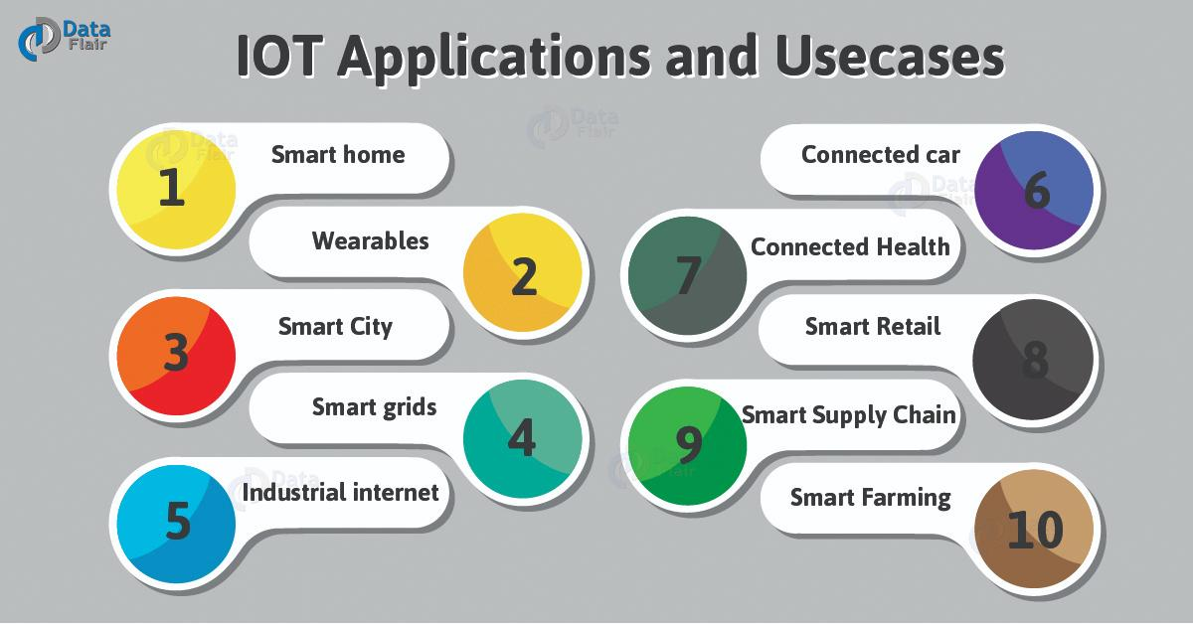
Applications of IoT
Notes:
For more information and examples, read the module.
You can categorize them into the three main groups mentioned earlier: consumer, enterprise, and industrial.
Smart Grid: It is an electrical grid (distribution network) which includes a variety of operations and energy dealings including: Advanced metering infrastructure (smart meter+), Renewable energy resources, Smart distribution boards and Circuit breakers, etc.
An electrical grid is an interconnected network for electricity delivery from producers to consumers.

Slide 41
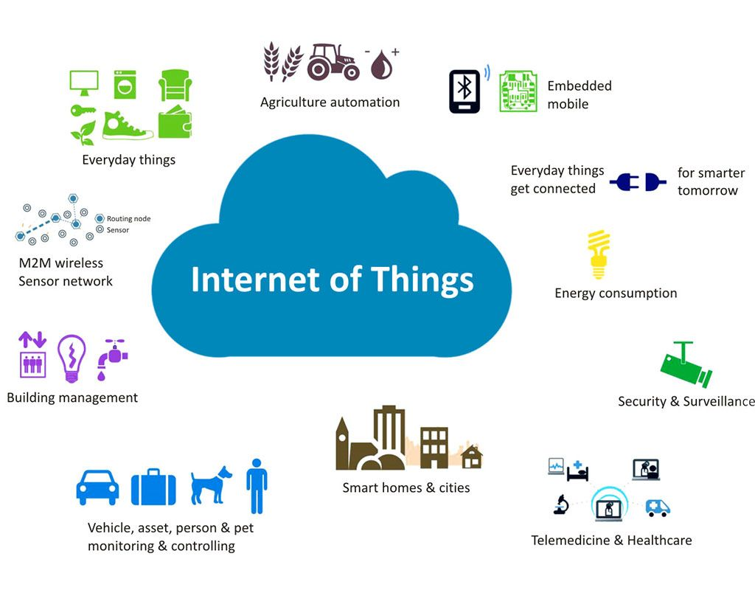
Applications of IoT
Notes:
For detailed information and more examples, read the module.

Slide 42
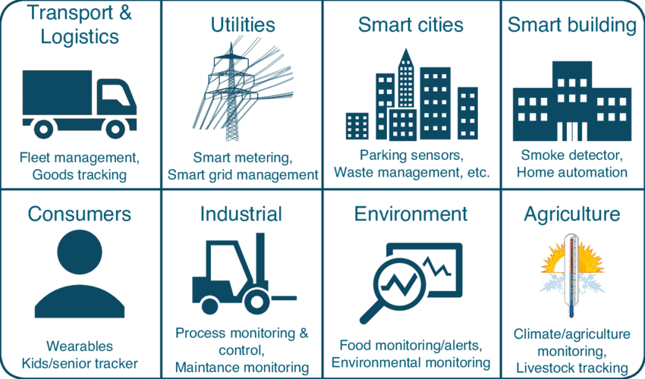
Applications of IoT
Notes:
For more information and examples, read module.

